Slide 1


Promotional Campaign Analysis
AtliQ Mart
By
Karan Khaire

Slide 2
Presentation Outline
AtliQ Mart
Problem Statement
Dataset Overview
AtliQ Mart Analysis
Store Performance Analysis
Promotion Analysis
Category And Product Analysis
Ad-hoc Requests
Key Findings
Recommendation

Slide 3
Problem Statement
AtliQ Mart
AtliQ Mart is a retail giant with over 50 supermarkets in the southern region of India. All their 50 stores ran a massive promotion during the Diwali 2023 and Sankranti 2024 (festive time in India) on their AtliQ branded products. Now the sales director wants to understand which promotions did well and which did not so that they can make informed decisions for their next promotional period.

Slide 4

Dataset Overview
AtliQ Mart
Dimension Tables:
dim_products
dim_campaigns
dim_stores
Fact Table:
fact_events
product_name
categories
Diwali
Campaign_name
Sankranti
Campaign time period
city
Store_id
promo_type
quantities_sold
base_price

Slide 5
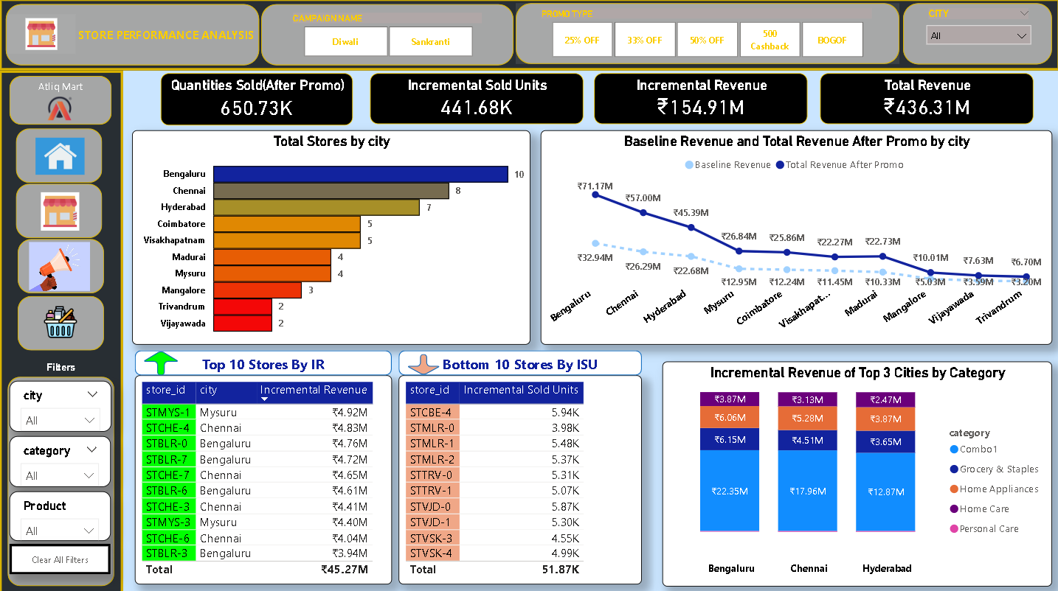
Store Performance Analysis Dashboard
AtliQ Mart

Slide 6
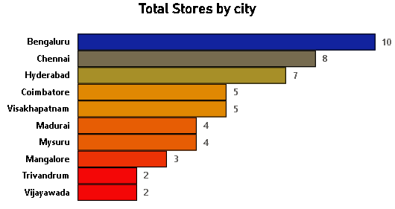
Store Performance Analysis
AtliQ Mart
Insights:
There are a total of 50 AtliQ Mart supermarkets in the southern region of India.
Bengaluru has the maximum number of stores i.e. 10 AtliQ stores.
Chennai has 8 AtliQ Stores.
Trivandrum and Vijayawada have 2 AtliQ stores each.

Slide 7
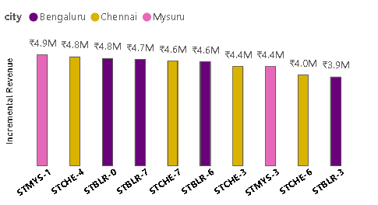
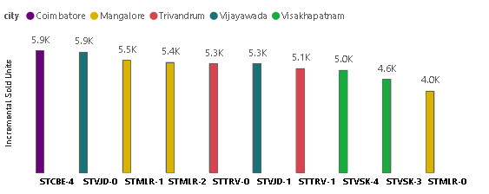
Store Performance Analysis by IR and ISU
AtliQ Mart
Incremental Revenue(Top 10 Stores)
Incremental Sold Units (Bottom 10 stores)
The stores in cities such as Mysuru, Bengaluru and Chennai had the highest IR.
The stores in cities Mangalore, Visakhapatnam and Trivandrum didn’t perform well during the promotional period.
The AtliQ Mart locations in cities like Bengaluru and Chennai experienced significant increases in quantities sold during the promotional activities.
Whereas the stores in Mangalore, Visakhapatnam, Trivandrum and Vijayawada recorded the lowest Incremental Sold Units during promotions.
In terms of both IR and ISU, AtliQ Mart stores in Bengaluru, Chennai and Mysuru demonstrated strong performance during Diwali and Sankranti.

Slide 8
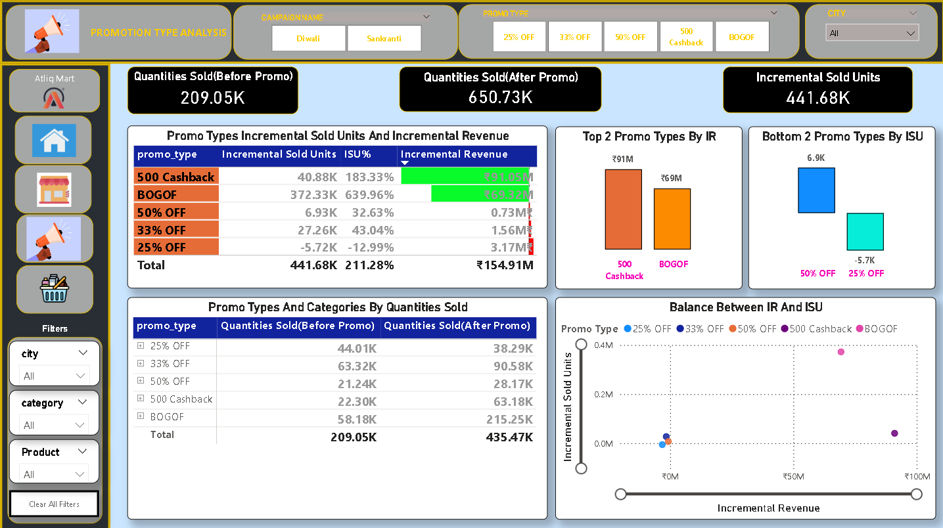
Promotion Type Analysis Dashboard
AtliQ Mart

Slide 9
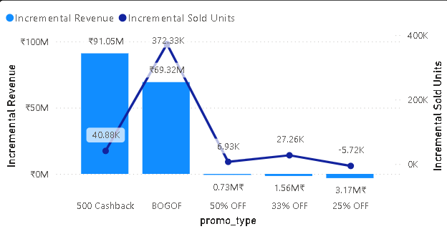
Insights from Promotion Type Analysis
AtliQ Mart
The ‘Buy One Get One Free’ (BOGOF) and ‘500 Cashback’ promotions showed high Incremental Revenue (IR) and Incremental Sold Units(ISU).
The '500 Cashback' promotion type achieved the highest Incremental Revenue (IR) at ₹91.05 million and Incremental Sold Units (ISU) at 40.88K. Following this, the 'BOGOF' promotion generated an IR of ₹69.32 million and an ISU of 172.33K.
Compared to the '500 Cashback' and 'BOGOF' promotions, discount-based promotions significantly underperformed in both Incremental Revenue (IR) and Incremental Sold Units (ISU).
The ‘500 Cashback’ and ‘BOGOF’ promotion types managed to successfully attract an impressive number of customers.

Slide 10
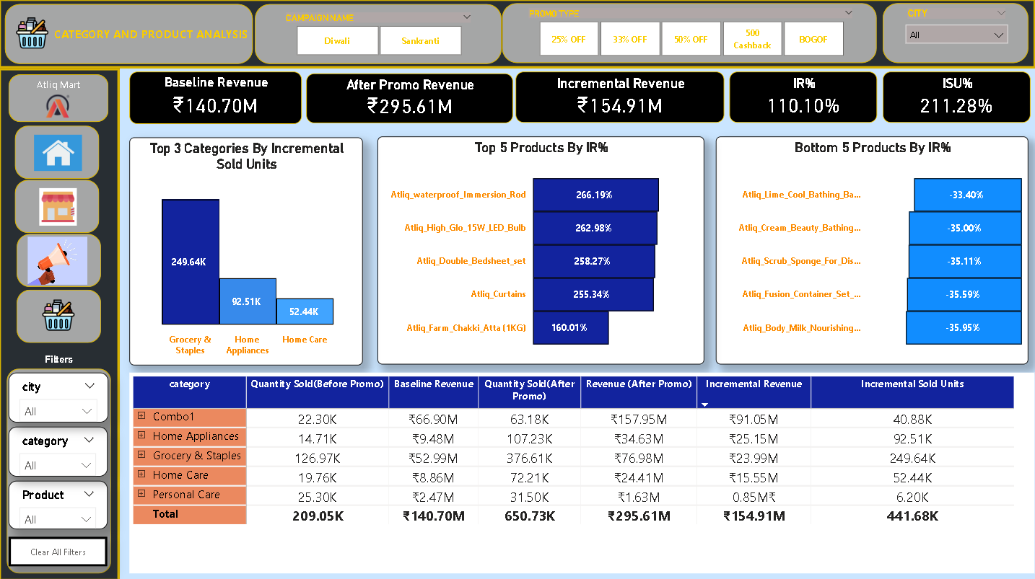
Category And Product Analysis Dashboard
AtliQ Mart

Slide 11
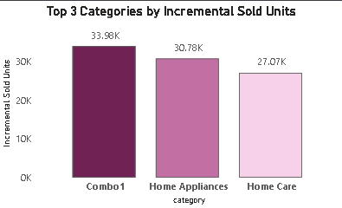
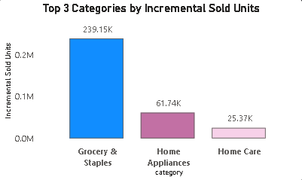
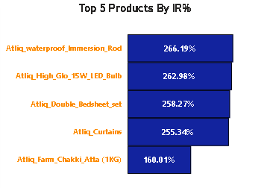
Category And Product Analysis
AtliQ Mart
During Diwali Campaign
During Sankranti Campaign
Top 5 products across both the Campaigns

Slide 12

Ad-hoc Request 1
AtliQ Mart
Provide a list of products with a base price greater than 500 and that are featured in promo type of 'BOGOF' (Buy One Get One Free). This information will help us identify high-value products that are currently being heavily discounted, which can be useful for evaluating our pricing and promotion strategies.

Slide 13
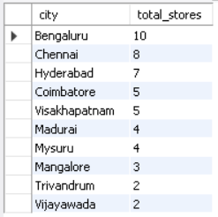
Ad-hoc Request 2
AtliQ Mart
Generate a report that provides an overview of the number of stores in each city. The results will be sorted in descending order of store counts, allowing us to identify the cities with the highest store presence. The report includes two essential fields: city and store count, which will assist in optimizing our retail operations.

Slide 14
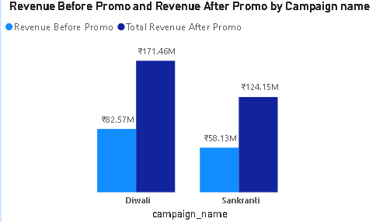

Ad-hoc Request 3
AtliQ Mart
Generate a report that displays each campaign along with the total revenue generated before and after the campaign? The report includes three key fields: campaign_name, total_revenue(before_promotion), total_revenue(after_promotion). This report should help in evaluating the financial impact of our promotional campaigns. (Display the values in millions)

Slide 15
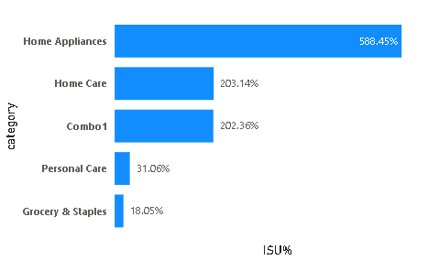
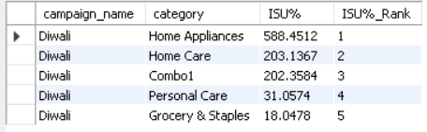
Ad-hoc Request 4
AtliQ Mart
Produce a report that calculates the Incremental Sold Quantity (ISU%) for each category during the Diwali campaign. Additionally, provide rankings for the categories based on their ISU%. The report will include three key fields: category, ISU%, and rank order. This information will assist in assessing the category-wise success and impact of the Diwali campaign on incremental sales.

Slide 16
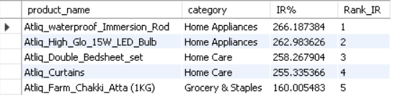
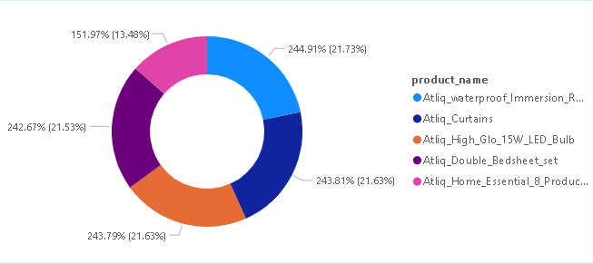
Ad-hoc Request 5
AtliQ Mart
Create a report featuring the Top 5 products, ranked by Incremental Revenue Percentage (IR%), across all campaigns. The report will provide essential information including product name, category, and IR%. This analysis helps identify the most successful products in terms of incremental revenue across our campaigns, assisting in product optimization

Slide 17
Key Findings
AtliQ Mart
Top Cities by both IR and ISU
Bengaluru, Chennai, Hyderabad
Top Promotion Types
Among the various promotions, the most effective ones were 'Buy One Get On Free' (BOGOF) and '500 Cashback’.
Top Products
Waterproof Immersion Rod, LED Bulbs, Atta, AtliQ Curtains and Bedsheets.

Slide 18
Recommendations
AtliQ Mart
Psychological Appeal: Cashback offers and free products appeal to customers' desire for savings and value, making them more likely to participate.
Simplicity: The promotions should be straightforward and easy to understand, reducing barriers to participation.
Feedback Mechanism: Implementing feedback mechanisms helps us to gather more insights from Customers about their promotion preferences and satisfactions.
Advertisements: Ads ensure maximum visibility of the products and promotion among the customers.

Slide 19
AtliQ Mart
THANK YOU

